Slide 1
New England Child Passenger Safety Conference September 9th, 2016
Vermont Agency of Transportation
Governors Highway Safety Program
Scott Davidson, GHSP Chief
Jim Baraw, Program Coordinator
Our Mission Statement
Working toward the goal of “Zero Deaths” by promoting highway safety awareness through education and enforcement, thereby reducing crashes, saving lives, and improving the overall quality of life for those using Vermont’s roadways.

Slide 2
Governor's Highway Safety Program
Where are we located?
The Vermont Governor's Highway Safety Program is located within the Agency of Transportation's Highway Division, Office of Highway Safety
One National Life Drive
Davis Building, Third Floor
Montpelier, Vermont 05633

Slide 3
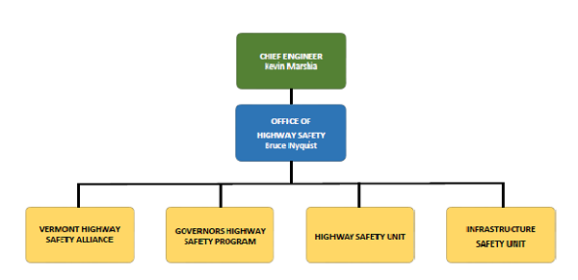
Governor's Highway Safety Program
Office of Highway Safety Structure
Notes:
Who is who, GHSP, Data, VHSA, and ISU. What do they all do?

Slide 4
Governor's Highway Safety Program
What we do…
Vermont Governor's Highway Safety Program awards federal highway safety grant funds to local, state and non-profit agencies for projects to improve highway safety and reduce deaths and serious injuries due to crashes.

Slide 5
Governor's Highway Safety Program
GHSP programs focus on the behavioral aspects of driver safety.
Speed and Aggressive Driving
Distracted, Impaired, and Drowsy Driving
Motorcycle Safety, Bicycle and Pedestrian Safety
and
Occupant Protection

Slide 6
Governor's Highway Safety Program
Our programs are defined and approved each year…
In the GHSP Highway Safety Plan. (One Year Plan)
Align with the State’s Strategic Highway Safety Plan. (Five Year Plan)
Through these plans, we…
Collect data,
Analyze data,
Identify problems,
Define emphasis areas,
Set goals
In order to fund and improve highway safety.

Slide 7
Governor's Highway Safety Program
Every Year the GHSP office must assemble
and submit the Highway Safety Plan (HSP)
What is the Highway Safety Plan?
2016 Vermont Highway Safety Plan

Slide 8
Governor's Highway Safety Program
Overall….
It’s the States Federal Grant Application to the National Highway Traffic Safety Administration (NHTSA).
It contains the planning, strategies and performance measures, as well as general oversight and management of highway safety strategies and projects
These are by the State either directly or through sub-recipients to address highway safety problems in the State.

Slide 9
Governor's Highway Safety Program
Keeping in mind, in the calendar year, we can have up to three grant cycles in process.
FFY 16 Close Out,
FFY 17 in Process,
FFY 18 in Planning
Along with all our other national campaigns such as…
Previous Year
Current
Year
Next
Year

Slide 10
Governor's Highway Safety Program
In the spring, we also conduct our
Grant applicant workshops,
An application review,
The application scoring,
The final grant approvals.
In the fall, we conduct our grant applicant financial workshops

Slide 11
Governor's Highway Safety Program
Some of our more important dates:
April of each year the FFY Grant cycle begins and lasts 20 months.
April 1st, 2016: FFY17 Grants cycle open for applications
May: Review and approve grants applications for HSP
May-June: FFY18 Highway Safety Plan ready for submission
August-Sept: Grant documents are prepared and go out.
October 1, 2016: Beginning of FFY17 New Grant Year
December 31, 2016: All 1st Quarter Requirements Due
May 30th, 2017 All 2nd Quarter Requirements Due
June 30th, 2017 All 3rd Quarter Requirements Due
September 30, 2017: Last Day of FY17 Grant Year
November 2017: Closeout for all FFY17 Grants.

Slide 12
How do we make improvements?
How do we know who?
How do we know what?
How do we know where?
How do we know when?
WE COLLECT DATA

Slide 13
NHTSA and the GHSP are data driven entities
Data determines…
The Who, What, Where and When of Highway Safety

Slide 14
We have many ways of collecting necessary data…
Crash Data (State)
FARS (Fatality Analysis Reporting System)
Occupant Protection Assessment
Seatbelt Survey
Driver Attitude Survey
Vermont Civil Violation Complaints (VCVC)

Slide 15
Crash Data
The Highway Research unit is responsible for all crash data submitted by law enforcement, including Web Crash, the Public Query Tool and the High Crash Location Report.
Mandy White Crash Data & FARS Analyst Tel: (802) 595-9341 Mandy.White@vermont.gov
Notes:
Brief on the PQT and the need for reports.

Slide 16
Fatality Analysis Reporting System
The Fatality Analysis Reporting System (FARS) contains data derived from a census of fatal traffic crashes within the 50 States, the District of Columbia, and Puerto Rico.
To be included in FARS, a crash must involve a motor vehicle traveling on a roadway resulting in the death of a person

Slide 17
OP Assessment
Mandated every three years (Required for funding)
NHTSA – State – Subject Matter Specialists.
Topics included are…
Legislation, Regulation, and Policy
Enforcement
Communication
Occupant Protection for Children
Outreach Program
Data and Evaluation Program

Slide 18
Seatbelt Survey
Mandated every year (Required for funding)
Currently use the UVM Traffic Research Center
Survey looks at…
Statewide sampling, ALL REGIONS
Times of day
County Data
All positions in the vehicle
Types of vehicles
Daytime for now, looking at nights

Slide 19
Vermont Child Passenger Safety Programs
CPS Data is hard to obtain.
Vermont GHSP is working with the UVM Traffic Research Center to include child-specific observational survey data in 2018.
Vermont GHSP in coordination with VDH has added questions to its annual Drivers Attitude Survey to address area’s of concern in CPS.
All so we can we make improvements in our Child Passenger Safety Programs

Slide 20
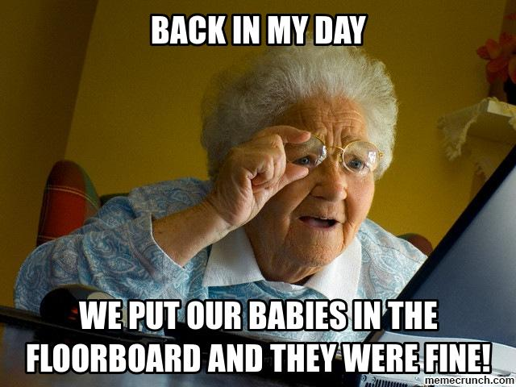
2016 Driver Attitude Survey

Slide 21
2016 Driver Attitude Survey Results
The largest group of survey respondents with an opinion,
25.1% noted that age eight was the appropriate age to move a child out of an approved child restraint.
Many, 45.8% were unsure while the remainder offered ages that ranged from one to eighteen.

Slide 22
2016 Driver Attitude Survey Results
Most, 84.2% noted it was not advised to place a rear facing infant seat in front of a working airbag.
However, 3.4% suggested they felt it was advisable to do so.

Slide 23
How does all of this data apply:
It allows us to focus on needs…
Media Campaigns
Enforcement Campaigns
Educational Campaigns
Designed to “Modify Personal Behavior”

Slide 24
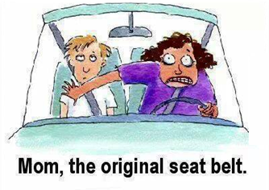
Occupant Protection
… is a protective device - seatbelt, air bag, child safety seat, booster seat, or helmet, which decrease death and/or injury in highway crashes.

Slide 25
Vermont Seat Belt Law Highlights
Vermont is…..
A secondary law state for Seatbelt use,
A primary law state for Child Passenger Safety seat use.

Slide 26
23 V.S.A. § 1259 "Seat Belt Use over the age of 18“
Everyone in the vehicle, including backseat passengers and children, must wear seat belts properly.
The driver will receive a fine of $25.00 for a first violation; $50.00 for a second violation; $100.00 for third and subsequent violations.
Lap and shoulder belts must be worn and shoulder belts must NOT be placed behind the back or under the arm.

Slide 27
23 V.S.A. § 1258 "Child restraint systems; persons under age 18“
All children under the age of one, and all children weighing less than 20 pounds, regardless of age, shall be restrained in a rear-facing position, properly secured in a federally-approved child passenger restraining system, which shall not be installed in front of an active air bag.
A child weighing more than 20 pounds, and who is one year of age or older and under the age of eight years, shall be restrained in a child passenger restraining system.
A child eight through 17 years of age shall be restrained in a safety belt system or a child passenger restraining system.
The driver will receive a fine of $25.00 for a first violation; $50.00 for a second violation; $100.00 for third and subsequent violations

Slide 28
Vermont Child Passenger Safety Programs
The Vermont CPS program is primarily funded by the Vermont GHSP.
They are located within the Vermont Department of Health Injury Prevention Unit
Staffed by two full-time VDH staff and many other volunteers and technicians statewide.

Slide 29
Vermont Child Passenger Safety Programs
The overarching goal of the Child Passenger Safety program is to decrease the number of deaths and injuries of children on Vermont’s public roadways due to motor vehicle crashes by promoting the proper and regular use of child safety seats and safety belts

Slide 30
Vermont Child Passenger Safety Programs
This is done by…
Reducing the barrier of cost of car seats to parents, grandparents, and other child-guardians by providing seats at reduced or no cost to families of needs.
Increase every community’s knowledge of the proper use of child restraints by offering car seat checks and one on one instruction and installation with the distribution of each seat purchased by this grant.
Offering education and re-certification training to certified car seat technicians who provide the community passenger safety checks and community education.

Slide 31
Vermont Child Passenger Safety Programs
Summary,
The National Child Restraint Use Special Study documents how car seats and booster seats are used in the field, drivers’ attitudes and beliefs about car seats and booster seats and their confidence with installing them.
National Child Restraint Use Special Study – NHTSA
https://crashstats.nhtsa.dot.gov/Api/Public/ViewPublication/812157

Slide 32
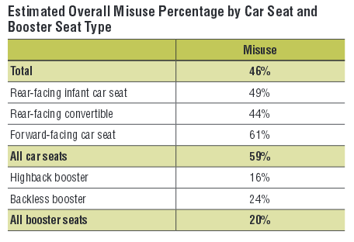
Vermont Child Passenger Safety Programs
Best practice recommendations for child passengers can be found at… www.safercar.gov/therightseat

Slide 33
Vermont CPS Contact Information
Tanya Wells, MSEd, CHES, CPST-I
Injury Prevention Program Administrator
Vermont Department of Health
108 Cherry St., Ste 201, Burlington, VT
Tanya.wells@vermont.gov
8802-318-0280 (Cell)
802-863-7596 (Office)
Sid Bradley, M. Ed. CPST
Child Passenger Safety Coordinator
Vermont Department of Health
108 Cherry St., Ste 201, Burlington, VT
Sidney.bradley@vermont.gov
802-497-7289 (Cell)
802-951-4089 (Office)

Slide 34
Our Educational Campaigns:
Turn off Texting program
Project Road Safe
Child Passenger Safety Program
Car Seat Checks
Bicycle & Pedestrian safety programs
Impaired, Distracted, Drowsy, and Drugged Driving
Motorcycle Safety
Drivers Education Classes

Slide 35
GHSP Media Campaigns to get the message out to the public.
Printed handouts
Newspapers
Radio Advertising
Child Passenger Safety Seats #1 August 2016
Child Passenger Safety Seats #2 August 2016
Television
Internet and Social Media (Facebook - Twitter - Linked-In - YouTube - Google - Etc.)
Other media outlets

Slide 36
Governor's Highway Safety Program
November: Thanksgiving Click It or Ticket Mobilization
December : Drive Sober or Get Pulled Over Mobilization
February: Impaired Driving (Super bowl)
March: Impaired Driving (St.Patricks Day)
April: U-Text, U-Drive, U-Pay
May: Bicycle Safety Month
May: Motorcycle Safety Awareness Month
May: Click It or Ticket Mobilization
July: Impaired Driving (4th of July week)
August: Drive Sober or Get Pulled Over Mobilization
August: Back to School Month
September: National Child Passenger Safety Week

Slide 37
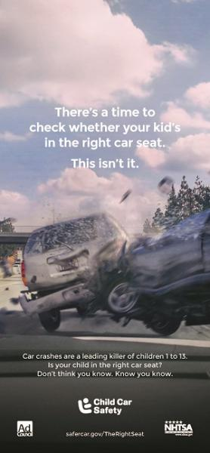
National Child Passenger Safety Week: September 18-24, 2016 National Seat Check Saturday: September 24, 2016
OCCUPANT PROTECTION Primary Message, "Is Your Child in the Right Car Seat" Twitter Chat: Child Passenger Safety
Additional National Child Passenger Safety Week campaign materials can be found at Traffic Safety Marketing
For additional Child Passenger Safety information here in Vermont, you can go to the Vermont Department of Health's "BeSeatSmart" page.
37

Slide 38
Example Enforcement Campaigns
Click It or Ticket is a national program to boost seat belt use and reduce highway fatalities through stepped up enforcement of seat belt laws, augmented by national and state media campaigns. It takes place each year around Memorial Day. Recent campaigns have focused on nighttime seat belt use because fewer people buckle up at night

Slide 39
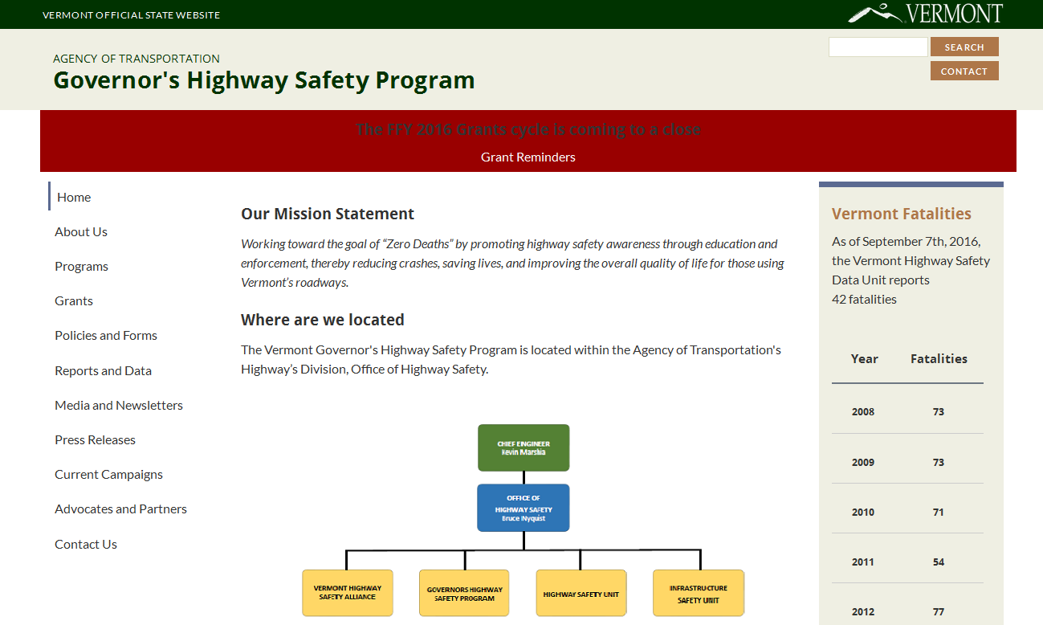
GHSP Web Site http://ghsp.vermont.gov/

Slide 40
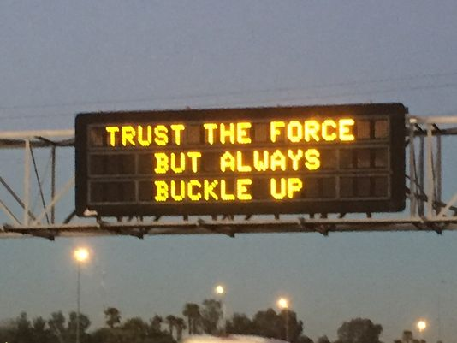
Any Questions?

Slide 41
GHSP Contact Information
Scott Davidson, Highway Safety Program Chief
Scott.davidson@vermont.gov
802-279-4006
Allison Laflamme Financial Manager II (802) 498-8079
Danielle Record, Highway Safety Grant Specialist 802-595-4402
Highway Safety Program Coordinator’s
Evelyn McFarlane, Law Enforcement Grants (802) 595-4661
James Baraw, Educational Grants 802-760-9222
Betsy Ross Impaired Driving and DRE Grants 802-585-9283
Contracted Field Personnel
Tom Fields
Law Enforcement Liaison
802-375-5913
Glen Button
Impaired Driving Project Manager
802-370-1318
Greg Nagurney
Traffic Safety Prosecutor
802-

